Slide 1
Modular Programming and Python Packaging

Slide 2

Content
1. Understanding Modular Programming
2. Python Packaging Basics
3. Case Studies and Practical Applications

Slide 3

Understanding Modular Programming
Section 1

Slide 4




What is Modular Programming?
Definition
Modular programming involves breaking down a program into separate, interchangeable modules.
Benefits
It enhances reusability, maintainability, and collaboration among developers.
Historical Context
Originating in the 1960s, it revolutionized software development.
01
02
03

Slide 5
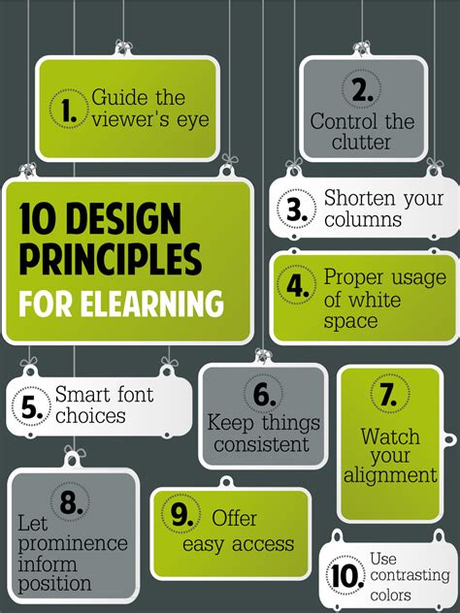

Principles of Modular Programming
Independence
Modules should function independently of one another.
Interchangeability
Modules should be replaceable with minimal impact on the system.
Encapsulation
Modules should encapsulate specific functionality.

Slide 6
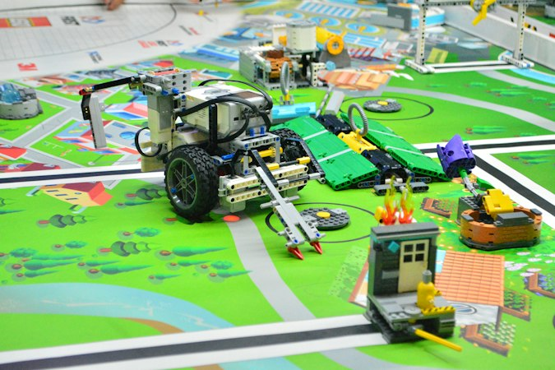
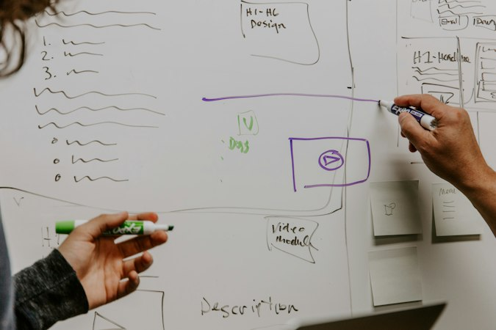
Implementing Modular Programming in Python
Module Creation
Python allows the creation of modular programs through separate .py files.
Importing Modules
The 'import' statement is used to import modules into Python programs.
Module Reusability
Python's modular approach enhances code reusability and maintainability.

Slide 7

Python Packaging Basics
Section 2

Slide 8
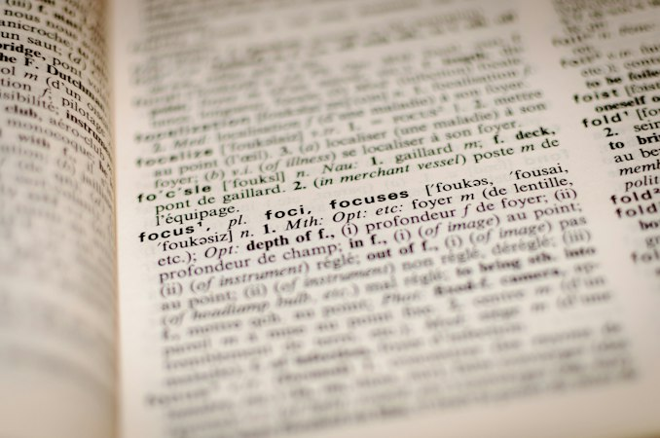
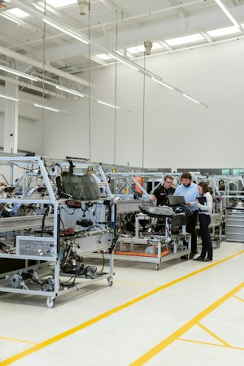

Understanding Python Packaging
Definition
Python packaging involves bundling modules and resources for distribution.
Packaging Tools
Python offers tools like setuptools and distutils for packaging.
Distribution Formats
Python packages can be distributed in formats like wheels and source distributions.

Slide 9
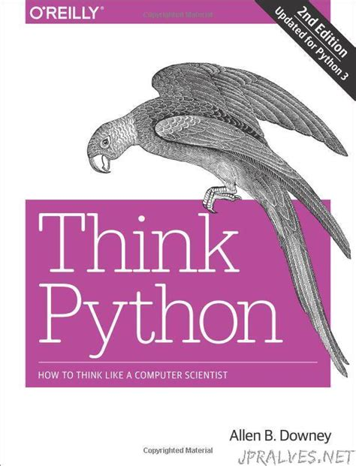
Creating Python Packages
Package Structure
Python packages have a specific directory structure with __init__.py files.
Metadata
Packages include metadata such as name, version, and dependencies.
Packaging Workflow
The process involves building, distributing, and installing packages.

Slide 10

Best Practices for Python Packaging
Versioning
Following semantic versioning for packages ensures compatibility.
Documentation
Including clear documentation enhances the usability of Python packages.
Testing and Continuous Integration
Testing and CI/CD practices are crucial for reliable packages.
01
02
03

Slide 11
Case Studies and Practical Applications
Section 3

Slide 12



Case Study: Django Framework
Modular Architecture
Django's design emphasizes modularity for scalability and maintainability.
Packaging Ecosystem
Django leverages Python packaging for its extensive ecosystem of reusable apps.
Community Contributions
The Django community actively contributes modular components and packages.

Slide 13
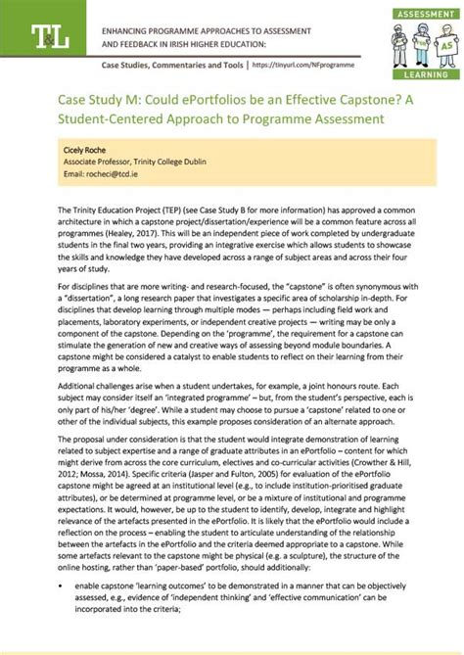
Case Study: NumPy and SciPy
Scientific Computing
NumPy and SciPy showcase the power of modular programming in scientific computing.
Package Interoperability
These libraries demonstrate seamless interoperability through modular design.
Performance Optimization
Modular architecture contributes to the performance of these scientific computing packages.

Slide 14
Practical Applications in Software Development
Microservices
Modular programming and Python packaging are integral to microservices architecture.
Open Source Contributions
Many open-source projects rely on modular programming and Python packaging for collaboration.
Industry Adoption
Real-world examples of companies leveraging modular programming and Python packaging for scalable software solutions.
01
02
03

Slide 15

Thank You

